Slide 1


Community pharmacy: A unified partner in mental health care
Community Pharmacy Sefton

Slide 2
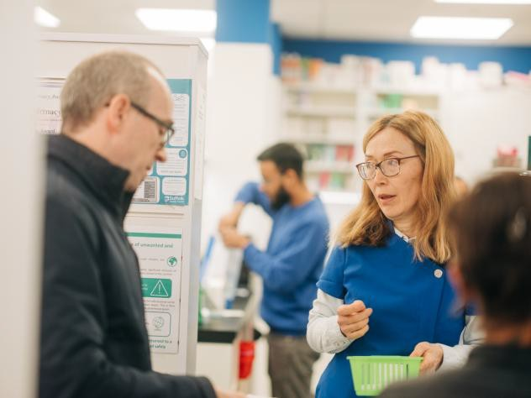

Background
The role of community pharmacy in proactive, joined up mental health care
Mental health conditions are common, often hidden, and can fluctuate
Community pharmacies provide and can provide
Trusted frequent contact, improving access to help
Early identification, spotting signs of early decline in health and wellbeing
Prevention, and public health support, coordinated care for long-term condition management
Working with neighbourhood teams in a joined up collaborative way

Slide 3

Offer 1
Community Pharmacy as the front door for mental health

Slide 4
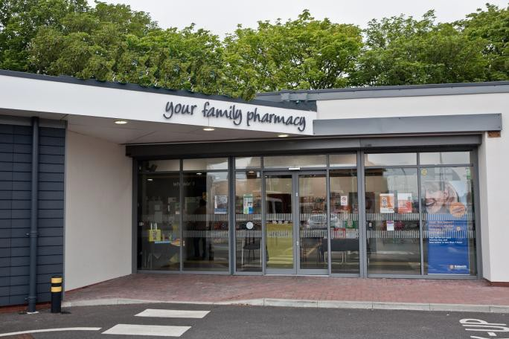
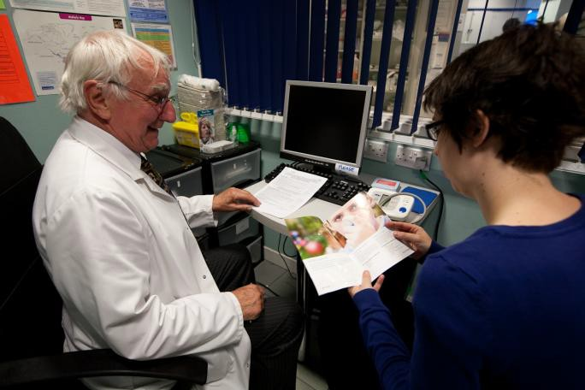
Community pharmacy as the front door for mental health
Accessible, no-appointment setting for early conversations, regular contact with people managing long-term conditions, able to spot early warning signs such as:
      Low mood, anxiety, or distress
      Changes in sleep or behaviour eg confusion
      Withdrawal or social isolation
      Poor self-care or medication adherence
Acting early to:
  Provide support eg with new medications and adherence
  Raise concerns
  Connect people to the right services
Helping prevent crisis presentations and escalation

Slide 5

Offer 2
Local intelligence from everyday conversations

Slide 6

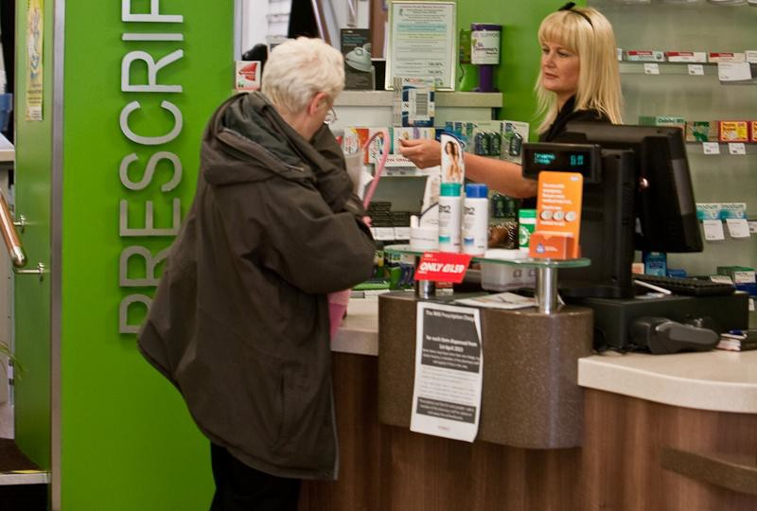
Local intelligence from everyday conversations
Understanding the person, not just the prescription
Pharmacy teams build trusted, long-term relationships with patients and carers. Informal conversations reveal important indicators such as:
Emotional distress or worsening mental health
Social isolation or loneliness
Carer strain or burnout
Early signs of relapse
Insights support: Holistic assessments
Shared care planning
Amplifying patient and carer voice within the neighbourhood system

Slide 7

Offer 3 Advice, education and
navigation

Slide 8
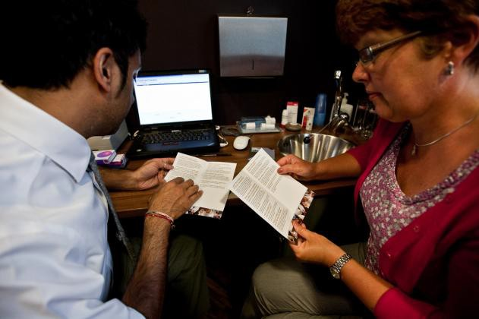

Advice, education and navigation
Supporting people to access the right mental health support. Providing practical advice on:
Medicines use and side effects (e.g. antidepressants, antipsychotics)
Sleep, wellbeing, and coping strategies
When and how to seek further help
Supporting carers with reassurance and guidance
Connecting people to:
GP and primary care teams
NHS Talking Therapies / psychological support
Social prescribing and voluntary sector services eg Dementia UK
Crisis and urgent support pathways
Reducing confusion and fragmentation in accessing care

Slide 9

Offer 4 Prevention and early intervention

Slide 10


Prevention and early intervention
Supporting resilience and early support before crisis.
Delivering prevention-focused interventions:
                Early support for mild to moderate mental health concerns
                Lifestyle advice (sleep, activity, alcohol use) /delivering NHS Healthchecks in the community
                Promoting social connection and wellbeing eg local warm hubs, Sean’s Place
Identifying and engaging:
  People not accessing traditional services
  Those at risk of deterioration
Contributing to neighbourhood prevention and population health strategies

Slide 11

Offer 5
Clinical expertise for safer medicines use

Slide 12
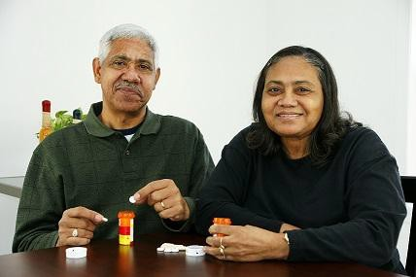

Clinical expertise for safer medicines use
Improving outcomes through medicines optimisation Supporting people taking mental health medications through:
New Medicine Service (NMS)
Discharge Medicines Service (DMS)
Ongoing adherence support
Providing materials for LD patients
Identifying and explaining risks such as:
Side effects (e.g. sedation, weight gain, metabolic impact)
Poor adherence or discontinuation
Withdrawal effects
Polypharmacy interactions
Risk of misuse or overdose
Supporting shared decision-making and personalised care

Slide 13
Offer 6
A committed partner in mental health pathways

Slide 14


A committed partner in mental health pathways
Co-designing services enabling consistent, person-centred care across the system
Working as part of the Integrated Neighbourhood Team
Community pharmacy is ready to:
Contribute to mental health identification and escalation pathways through new and existing locally commissioned services, eg
Dementia screening,
NHS Healthchecks within the local pharmacy
Alcohol brief intervention service,
Falls service,
Substance misuse service users wellbeing check,
ADHD monitoring service
Smoking Cessation services
Screening for anxiety and depression (e.g. PHQs)

Slide 15
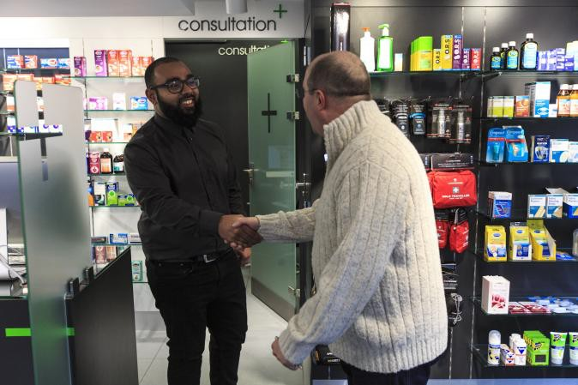

The value for the INT
Why community pharmacy matters for mental health:
Earlier identification of mental health deterioration by sharing insights and intelligence with partners. We are a trusted, accessible point of contact
Reduced pressure on urgent and acute services
Support continuity across services eg Discharge Medicine Service for patients discharged from hospital
Improved medicines safety and adherence resulting in better patient and carer experience
Reduced stigma through informal, community-based support
Stronger prevention and neighbourhood resilience
Improves access to advice and support for the whole community so reduces inequalities

